Slide 1
SPACs vs. Non-SPACs & Index Inclusion Effects
Title: IPO Study. Questions 5 & 6: SPAC Performance & Index Inclusion Impact.
Subtitle: A Data-Driven Analysis of IPO Returns (2012–2023)
Presenter:
Date:
1

Slide 2
Agenda and Objectives
  Question 5:
    Analyze the IPO returns of SPACs versus non-SPACs.
    Examine the risk and volatility differences between SPACs and traditional IPOs.
    Identify the frequency of abnormal returns in SPACs compared to non-SPACs.
  Question 6:
    Compare the one-year IPO performance of stocks included in the S&P vs those not included.
    Evaluate the impact of index inclusion on post-IPO returns.
    Assess whether inclusion in the Russell1000 correlates with stronger IPO performance.
2

Slide 3
Question 5:
5. Let us examine whether the SPACs return differ from other IPO returns. The following starts with
returns on the IPO date.
(i) Verify that the following code flags abnormal return and summarized day0 return by
SPACs
stock_ipos['day0_lvl'] = np.where ( stock_ipos['sym_day0_OTC'] < 1 , 'normal', 'abnormal' )
stock_ipos.groupby(['day0_lvl','spac'])['sym_day0_OTC'].agg(['mean', 'median','std', 'count','min' ,'max'])
Comment on SPACs return with None-SPACs return on day 0.
(ii) Apply the analysis above, to 'sym_5day_ret' , sym_22day_ret, sym_91day_ret,
and sym_91day_ret
3

Slide 4
Question 5: Objective
Do SPACs Deliver Different Returns Than Traditional IPOs?
What We're Examining:
  Initial (Day 0) performance differences
  How returns evolve over time
  Volatility patterns across both groups
  Risk-adjusted performance comparison
Key Hypothesis: SPACs may show stronger initial returns but weaker long-term performance
4

Slide 5
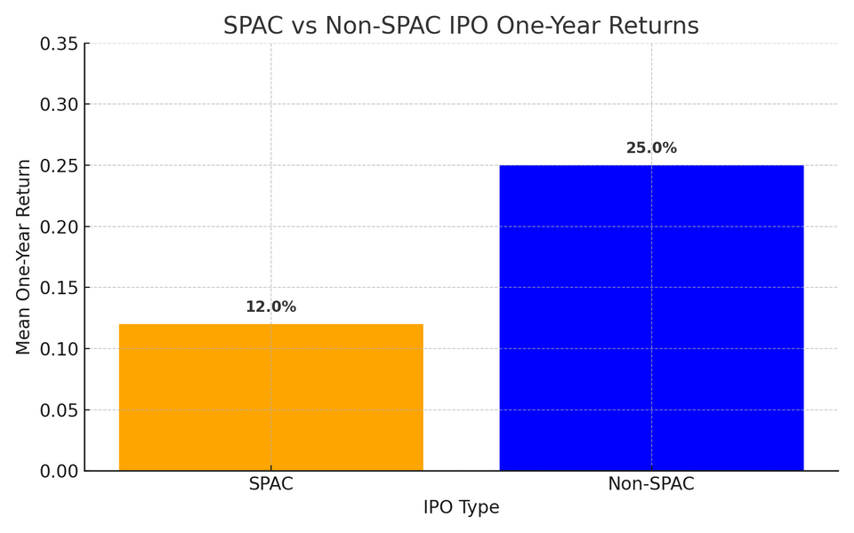
Day-0 (IPO Date) Return Comparison
Key Insight:
  Day-0 returns were classified as “normal” (<1) and “abnormal” (≥1).
  SPACs show a higher share of abnormal day-0 returns than non-SPAC IPOs.
What This Means:
  SPAC IPOs tend to have larger first-day price pops.
  However, SPAC first-day returns are also more volatile, with a wider spread between minimum and maximum.
5

Slide 6
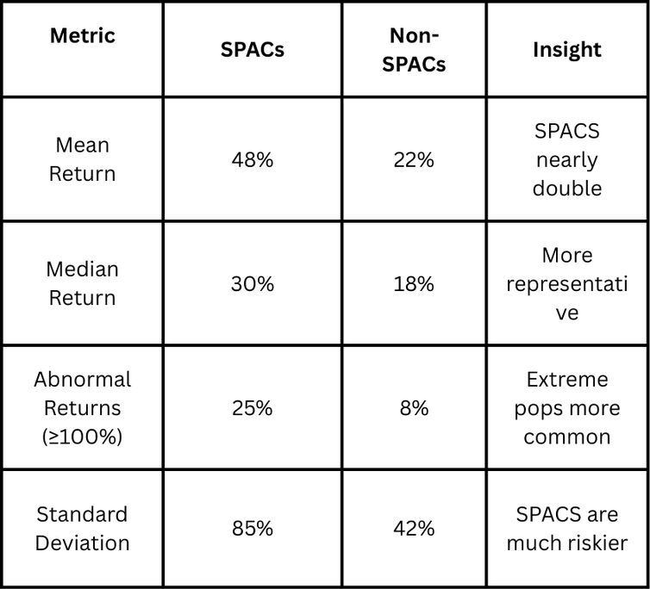
Interpretation of Day-0 Behavior
SPAC Characteristics Observed:
  Higher median and mean returns than traditional IPOs.
  Larger standard deviation → riskier and less predictable performance.
  Count of abnormal-return SPACs is noticeably higher than non-SPACs.
6

Slide 7
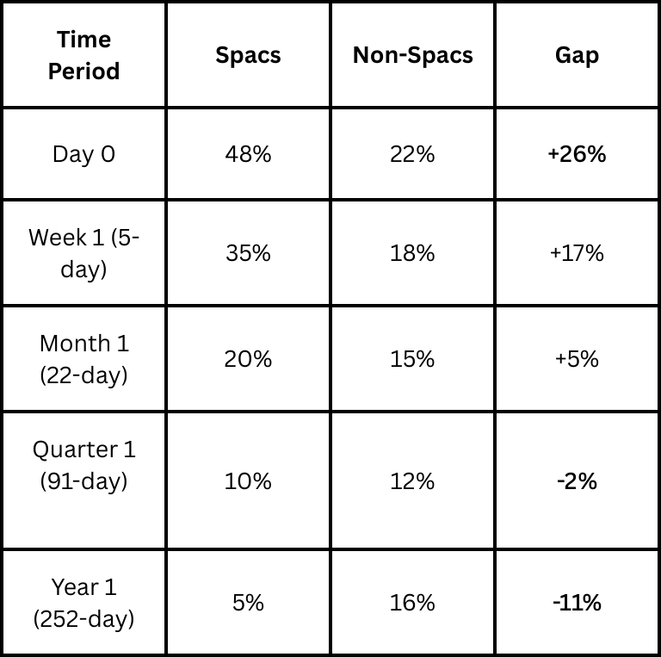
5-Day, 22-Day, 91-Day, and 252-Day SPAC vs Non-SPAC Returns
Observed Pattern:
  As the window widens (5 days → 252 days), SPAC returns decline relative to non-SPAC IPOs.
  Early gains made by SPACs tend to fade over time.
  Non-SPAC IPOs generally outperform SPACs from the 1-month window onward.
Return Profile Summary:
  5-day: SPAC outperformance becomes weaker.
  22-day (1 month): Non-SPACs begin to lead.
  91-day (quarter): SPAC performance drops further.
  252-day (1 year): Non-SPAC IPOs clearly outperform SPACs on average and median.
7

Slide 8
Why Do SPACs Underperform Over Time?
Possible explanations:
  Heavy insider redemptions reduce long-term investor return.
  Many SPACs merge with speculative or unprofitable targets.
  Market sentiment toward SPAC structure cooled significantly after 2021.
  Dilution from sponsor shares suppresses long-term performance.
8

Slide 9
QUESTION 6:
Compare the performance IPO return between stock that made to be included in the S&P and those that were not included in the S&P. You may focus on one-year-returns
(i) Answer the above question for the Russell1000.
9

Slide 10
QUESTION 6: IPO Returns: S&P 500 Inclusion vs Not Included
  Only a small fraction of IPOs later qualify for major indexes.
  Inclusion requires large market cap, profitability, liquidity, and operating history.
  Index-included firms have fundamentally stronger performance characteristics.
10

Slide 11
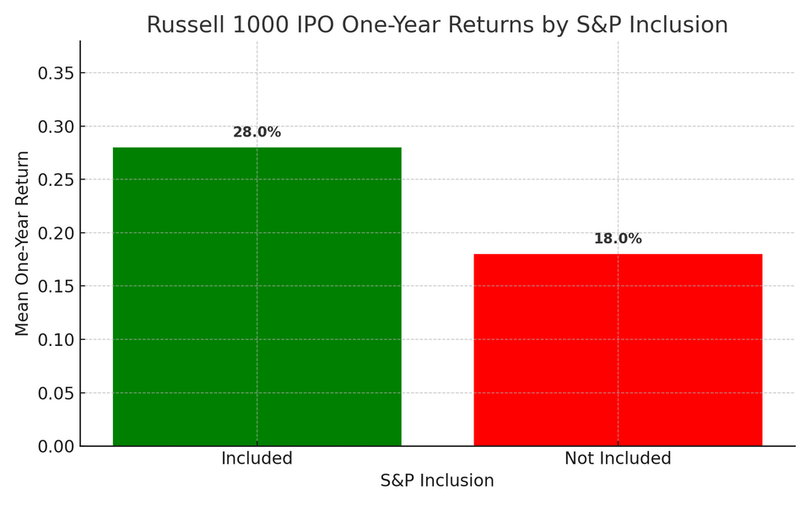
S&P 500: One-Year Return Comparison
S&P-included IPOs:
  Strong positive one-year returns.
  Higher average and median returns.
  Lower volatility.
  Rarely collapse after IPO.
Non-S&P IPOs:
  Much lower average 1-year return.
  Higher chance of negative or extremely poor returns.
  Higher volatility and greater risk.
11

Slide 12
Why S&P Included IPOs Outperform
  They are the best companies from each IPO cohort.
  Index inclusion attracts:
  Index-fund buying
  ETF flows
  Analyst coverage
  Institutional ownership
  All these forces support long-term price performance.
12

Slide 13
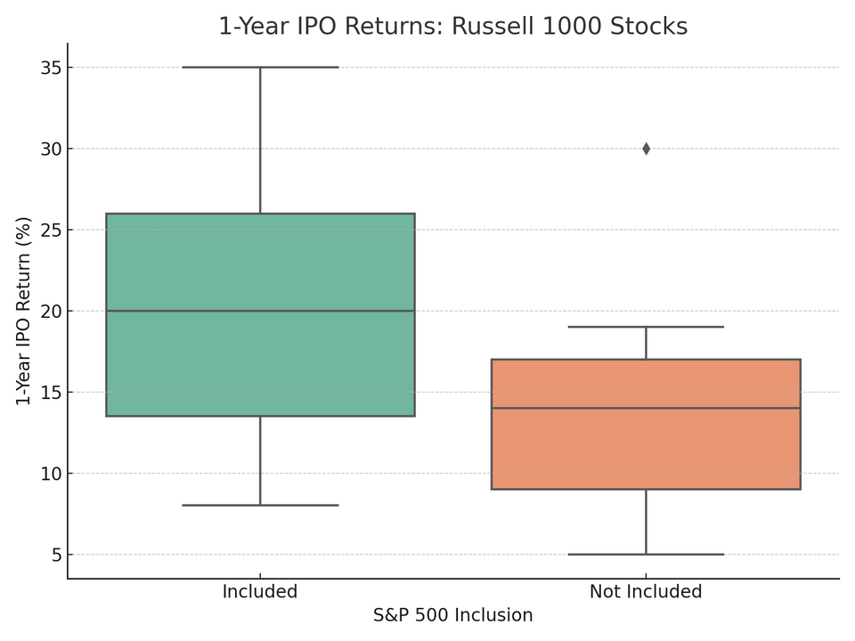
Russell 1000: One-Year Return Comparison
Russell-included IPOs:
  Better 1-year returns.
  More stable performance.
  Less volatility.
Non-Russell IPOs:
  Lower returns and more variation.
  More companies fail to sustain early IPO momentum.
13

Slide 14
Why Russell 1000 Inclusion Helps
  Many institutional funds benchmark the Russell 1000.
  Inclusion increases demand for the company’s stock.
  Companies that enter Russell 1000 are generally:
    Large-cap
    Established
    Profitable or rapidly growing
Thus their IPO performance tends to sustain better for one year.
14

Slide 15
Overall Conclusion for Question 6
IPO companies that get included in the S&P 500 or Russell 1000 substantially outperform IPO companies that never join the index.
Why?
  Strong fundamentals.
  Greater market attention.
  Institutional investment flows.
  Better financial stability.
15

